Slide 1


Introduction to Linear Regression in Machine Learning
By
Abhijit Challapalli
Graduate Research Assistant
Masters in Data Science

Slide 2

What is Machine Learning?
Definition: Machine Learning is a subset of AI that enables systems to learn from experience without explicit programming.
Goal: Enable computers to learn automatically without human intervention.
Types of Machine Learning:
Supervised Learning: Learning from a labeled dataset.
Unsupervised Learning: Learning from data without labels.
Reinforcement Learning: Learning to make decisions through trial and error.

Slide 3
The Importance of Machine Learning
Everyday Applications: From streaming recommendations to predictive text.
Business and Healthcare: Optimizing operations and advancing R&D.
Future Innovations: AI in medicine, and smart cities.

Slide 4
Supervised Learning
Supervised learning is a machine learning approach that’s defined by its use of labeled datasets. These datasets are designed to train or “supervise” algorithms into classifying data or predicting outcomes accurately. Using labeled inputs and outputs, the model can measure its accuracy and learn over time
Supervised learning can be separated into two types of problems when data mining: classification and regression:
Classification
Regression

Slide 5
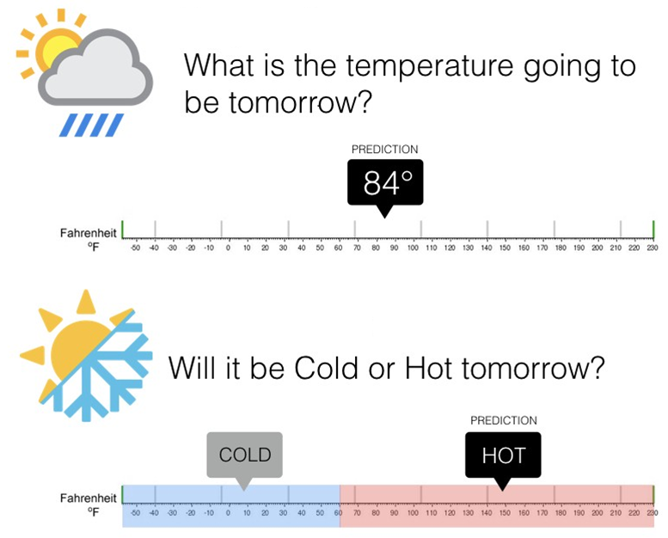
Regression ←→ Classification
Regression algorithms predict a continuous value based on the input variables.
Classification is the problem of identifying which of a set of categories an observation, belongs to

Slide 6
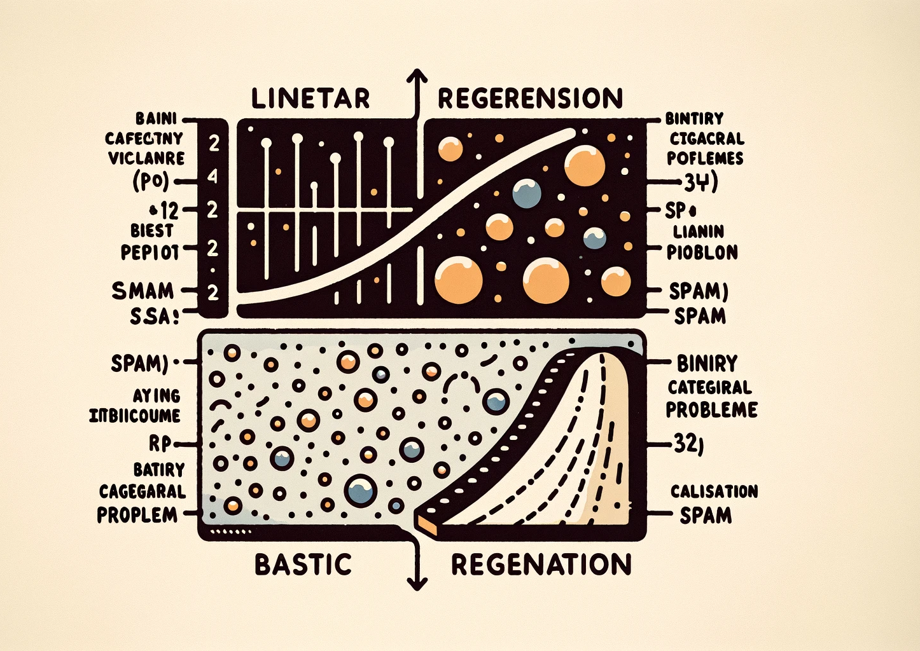
Regression
Linear Regression is used for continuous dependent variables, predicting outcomes based on the linear relationship with one (simple) or more (multiple) independent variables. It uses a straight line of best fit derived through the least squares method.
Logistic Regression, in contrast, is used for categorical dependent variables, ideal for binary classification problems like spam detection. It differentiates outcomes using a sigmoid curve to represent binary options, such as "yes" or "no."

Slide 7
Linear Regression
Linear regression is one of the most commonly used techniques in statistics. It is used to quantify the relationship between one or more predictor variables and a response variable.
Simple linear regression, which is used to quantify the relationship between one predictor variable and one response variable.
Multiple linear regression, if we have more than one predictor variable

Slide 8
Use Cases
causal analysis
forecasting an effect
trend forecasting.

Slide 9
Causal analysis
Business: Is there a relationship between advertising spending and revenue?
Medicine: Does the drug dosage have affect blood pressure of patients? Has the body weight an influence on the blood cholesterol level?
Agriculture: How fertilizer and water change crop yields.
Psychology: Is anxiety influenced by personality traits?
Biology: Does the oxygen level in water stimulate plant growth?

Slide 10
Forecasting
Once we have our model, we can use it on new data to predict future values:
Medicine: With X cigarettes smoked per day, the life expectancy is Y years.
Biology: For five additional weeks of sunshine the sugar concentration in vine grapes will rise by X %
Management: With X amount of dollars spend on marketing, sales should be Y.

Slide 11
Predict trends in data
Medicine: By how many years does the life expectancy decrease for every additional pound overweight?
Biology: With every additional week of sunshine the sugar concentration in vine grapes will rise by Y%.

Slide 12
Pros and Cons
Pros of Linear Regression:
Simple Model: Easily expresses the relationship between multiple predictors and the predicted variable.
Computational Efficiency: Fast modeling and prediction, ideal for large datasets.
Interpretable Output: Determines the influence of independent predictors on the predicted value effectively.
Cons of Linear Regression:
Overly-Simplistic: May not capture complex real-world data relationships.
Linearity Assumption: Presumes a linear relationship between independent and dependent variables, which may not always exist.
Independence of Variables: Assumes non-correlated predictors, an uncommon scenario in practice.

Slide 13

Stepping into Linear Regression
Components:
Dependent Variable (Y): This is the variable that we are interested in and want to model; such as sales of a particular product, or the stock price of a publicly traded firm.
Independent Variables (X): a set of variables that we think might be useful in predicting or modelling the response variable .

Slide 14

RESPONSE VARIABLE versus PREDICTING VARIABLE?
Response Variable: It is a Random Variable. It varies with changes in the predictor/s along with other random changes.
Predicting Variable: is a Fixed Variable. It does not change with the response but it is set fixed before the response is measured.

Slide 15
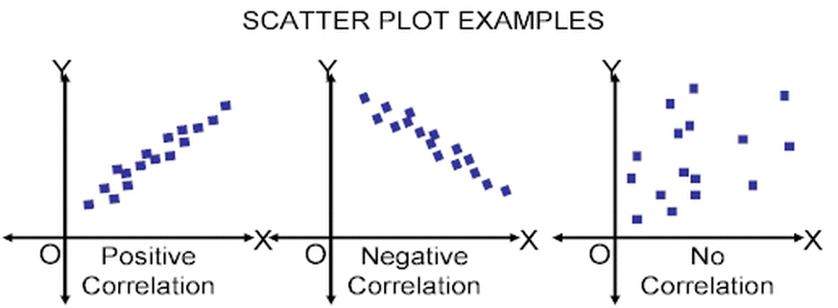
Two analyses study association of continuously measured variables
Correlation analysis: Concerned with measuring the strength and direction of the association between variables. The correlation of X and Y (Y and X).
Linear regression: Concerned with predicting the value of one variable based on (given) the value of the other variable. The regression of Y on X.

Slide 16
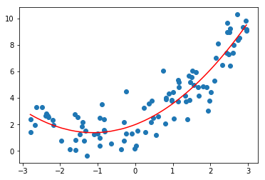
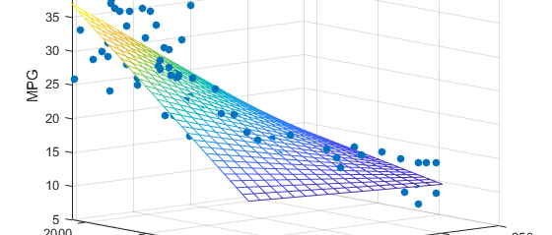
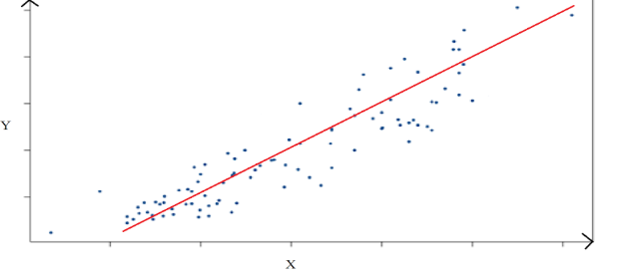

General Model
Simple linear regression Y = $β$₀ + $β$₁X + $\text{ε}$
Multiple linear regression Y = $β$₀ + $β$₁X₁ + $β$₂X₂ + $\text{ε}$
Polynomial Regression Y = $β$₀ + $β$₁X +$β$₂X² + $\text{ε}$

Slide 17
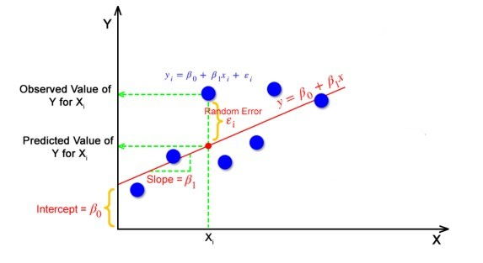
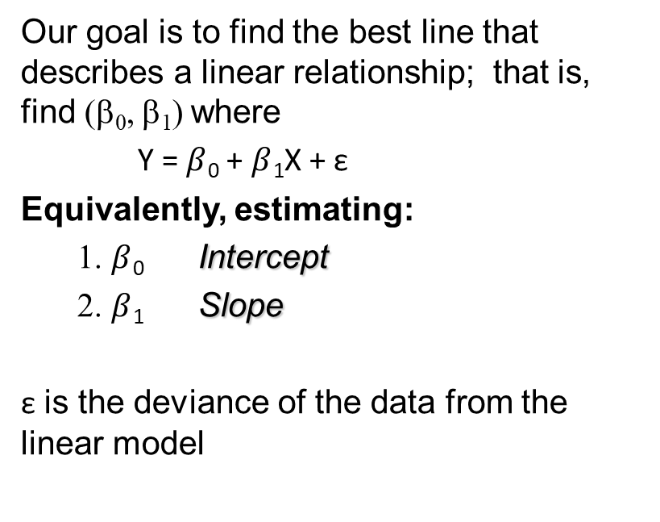
Goal
Our goal is to find the best line that describes a linear relationship; that is, find (β₀, β₁) where
Y = $β$₀ + $β$₁X + $\text{ε}$
Equivalently, estimating:
1. $β$₀ Intercept
2. $β$₁ Slope
$\text{ε}$ is the deviance of the data from the linear model

Slide 18
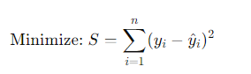
What is OLS?
Definition: OLS(Ordinary Least Square) is the most common method used in linear regression for estimating the unknown parameters in a linear regression model.
Mathematical Formula:
Interpretation: The best-fitting line is the one where the sum of the squared differences is the smallest possible.

Slide 19
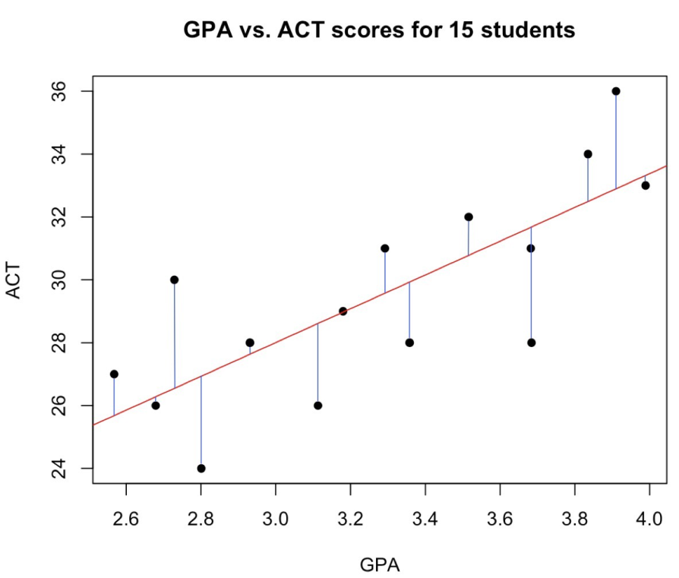
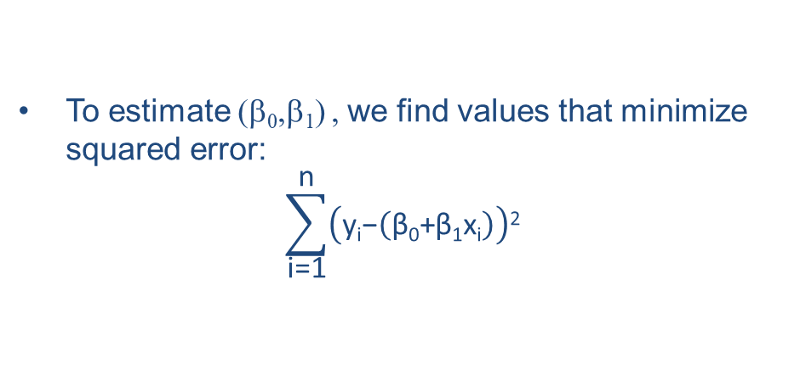
Calculation
To estimate (β₀,β₁) , we find values that minimize squared error:
$$\sum_{\text{i}\text{=1}}^{\text{n}}{\left(\text{y}\text{i}\text{−}\left(\text{β}\text{0}\text{+}\text{β}\text{1}\text{x}\text{i}\right)\right)\text{2}}$$

Slide 20
Objectives
Use OLS to fit a line to the data
Calculate R² (squared) value
Calculate p-value for R² value

Slide 21
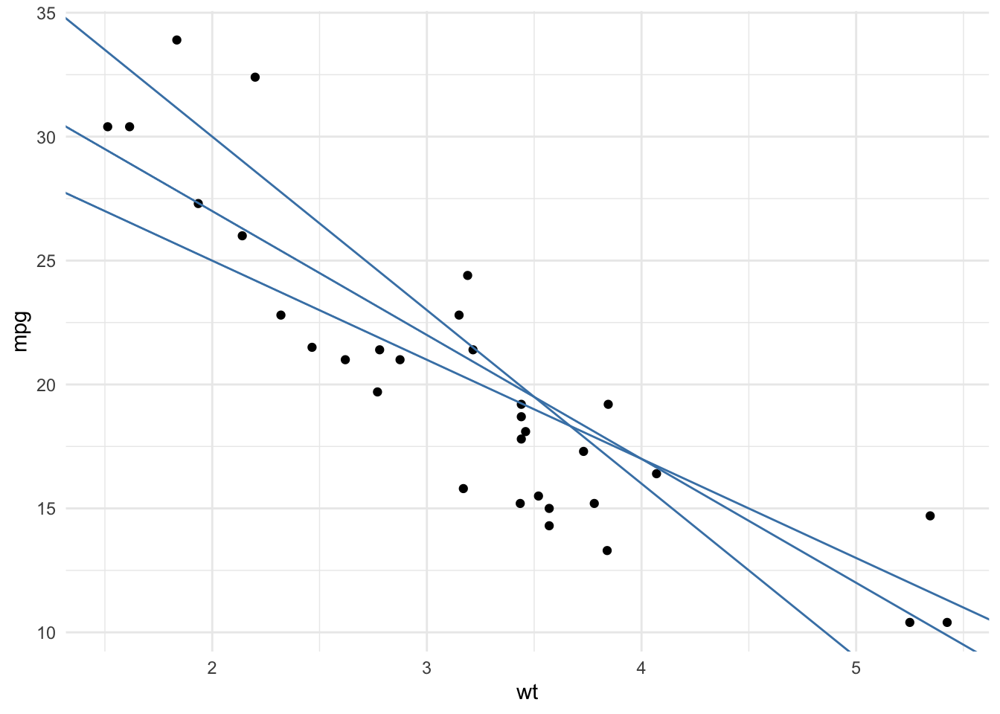
Step1
To find the line which passes as close as possible to all the points, we take the square of the vertical distance between each point and each potential line. Note that we take the square of the distances to make sure that a negative gap (i.e., a point below the line) is not compensated by a positive gap (i.e., a point above the line). The line which passes closest to the set of points is the one which minimizes the sum of these squared distances.

Slide 22
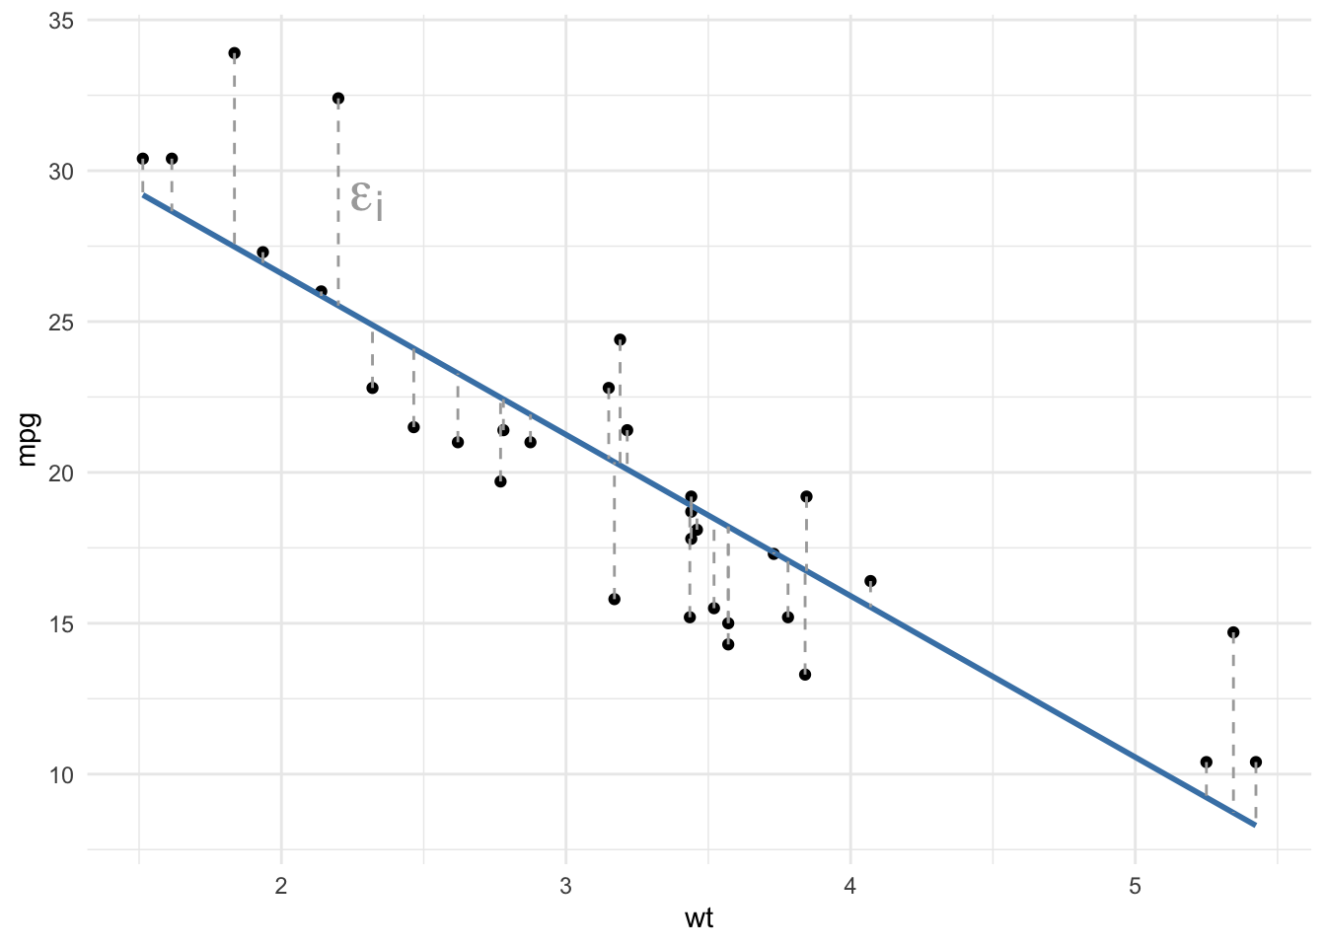
Step2
The resulting regression line is presented in blue in the following plot, and the dashed gray lines represent the vertical distance between the points and the fitted line. These vertical distances between each observed point and the fitted line determined by the least squares method are called the residuals of the linear regression model and denoted ϵ.

Slide 23
Coefficient of determination R2
The coefficient of determination, R², is a measure of the goodness of fit of the model. It measures the proportion of the total variability that is explained by the model, or how well the model fits the data.
R² varies between 0 and 1:
R² =0: the model explains nothing
R2=1: the model explains everything
0< R² <1: the model explains part of the variability
the higher the R², the better the model explains the dependent variable. As a rule of thumb, a R² >0.7 indicates a good fit of the model

Slide 24
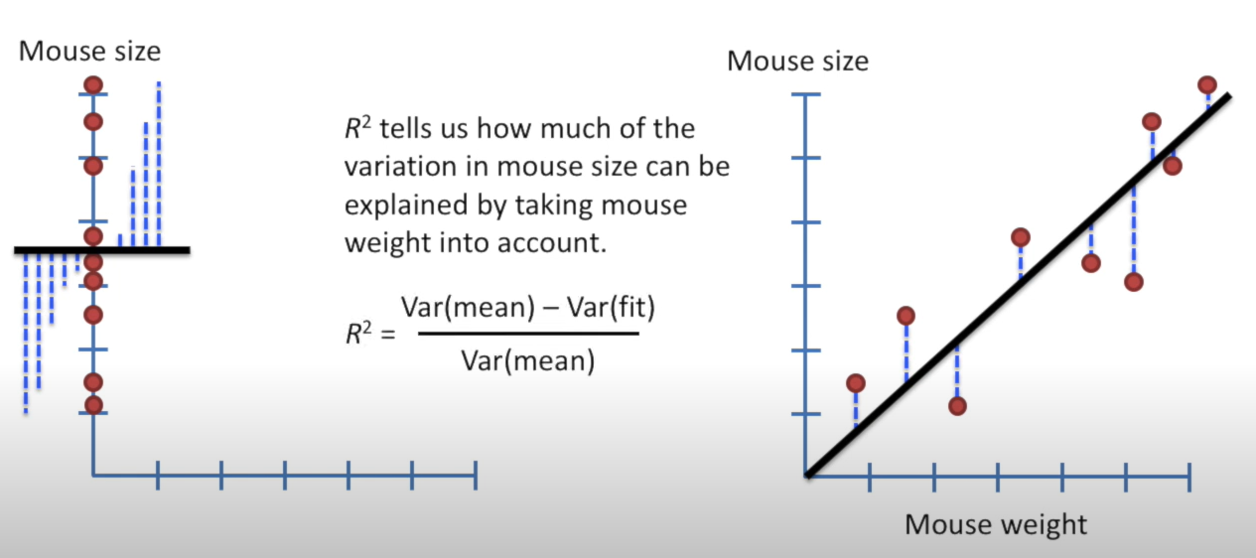
Calculation

Slide 25
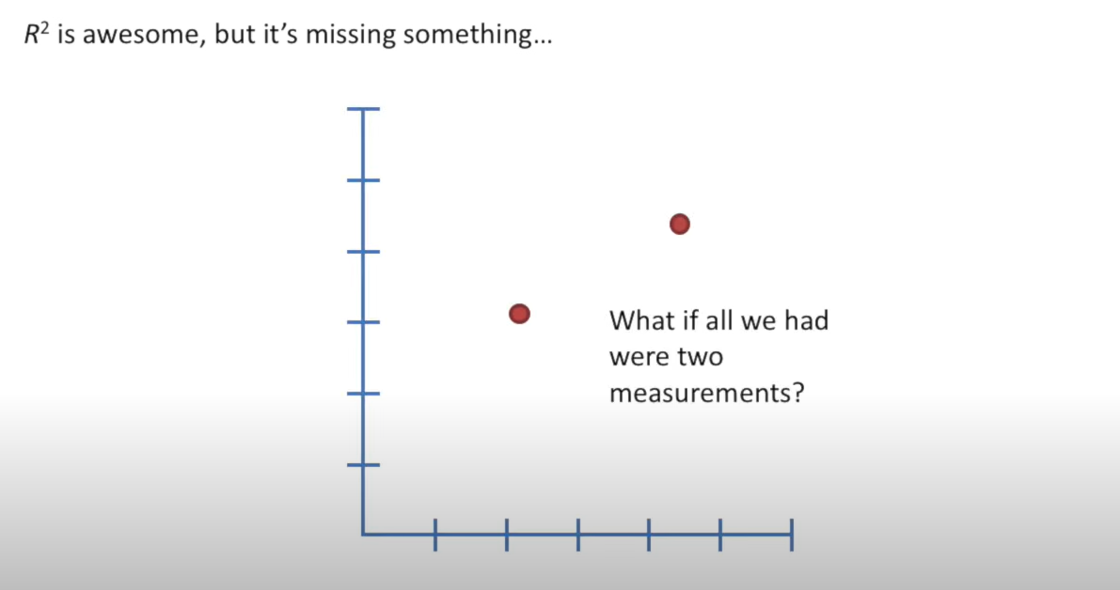
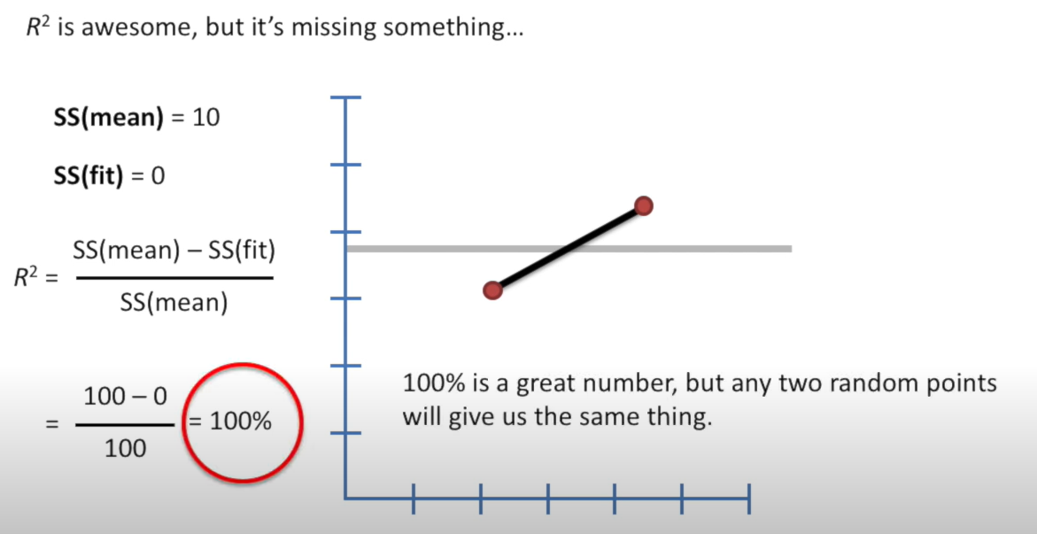
Continuation
Or what if the model is overfitted??

Slide 26
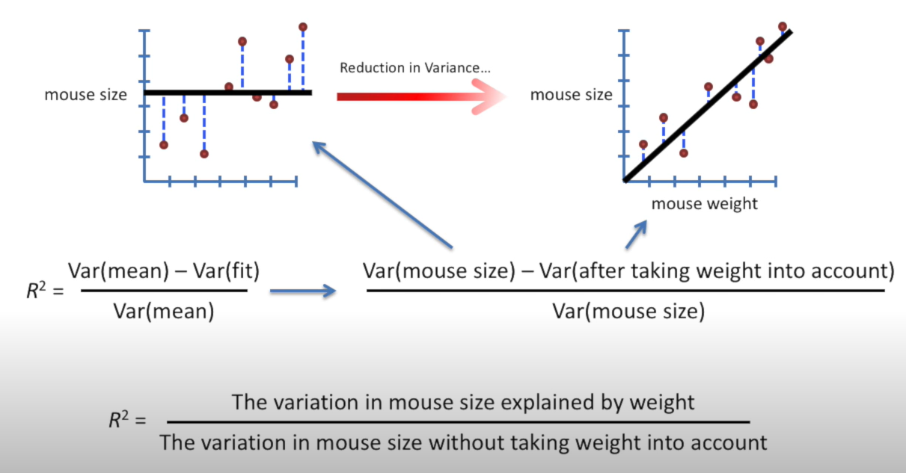
Review of R²

Slide 27
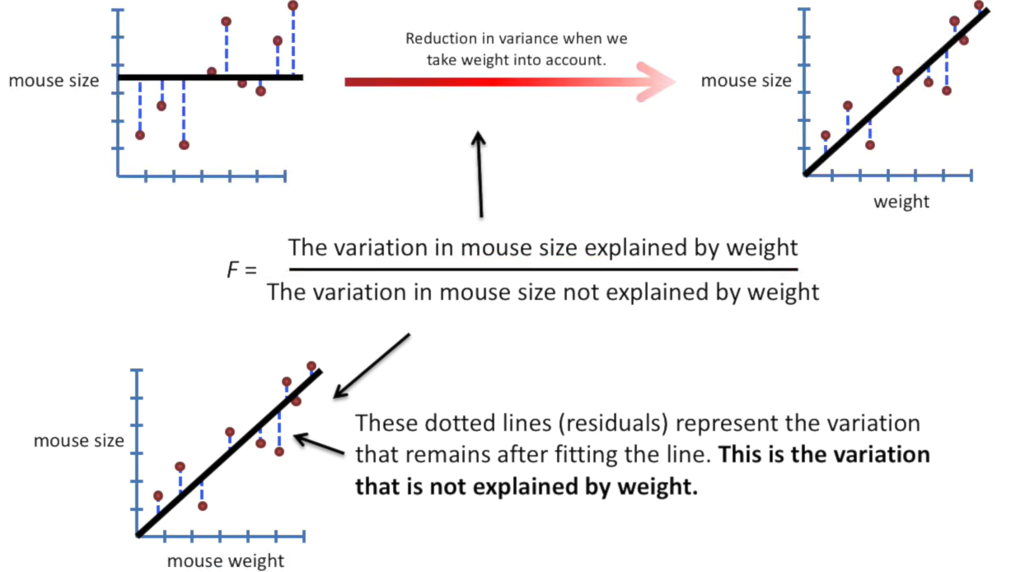
Significance of the model
Calculating the F-statistics to determine the significance of the model.

Slide 28
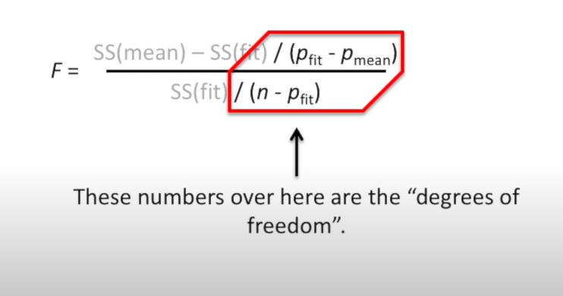
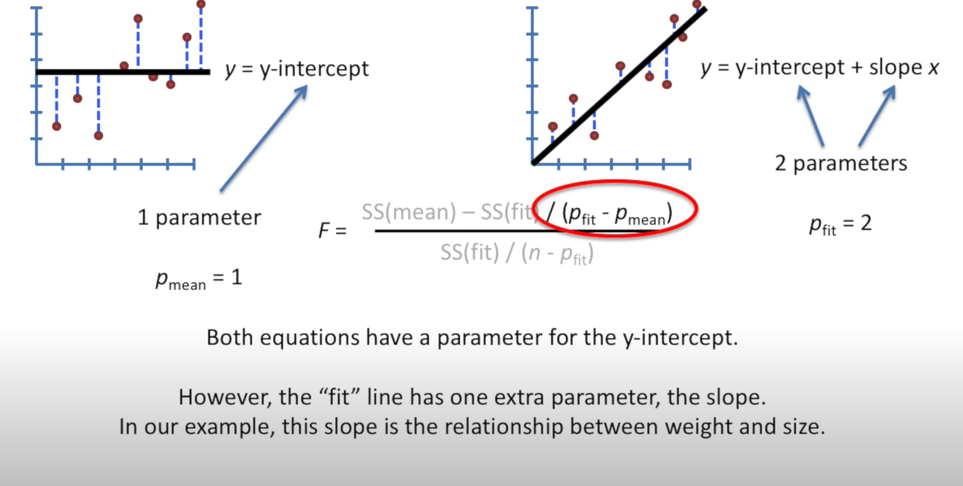
Calculating F value

Slide 29
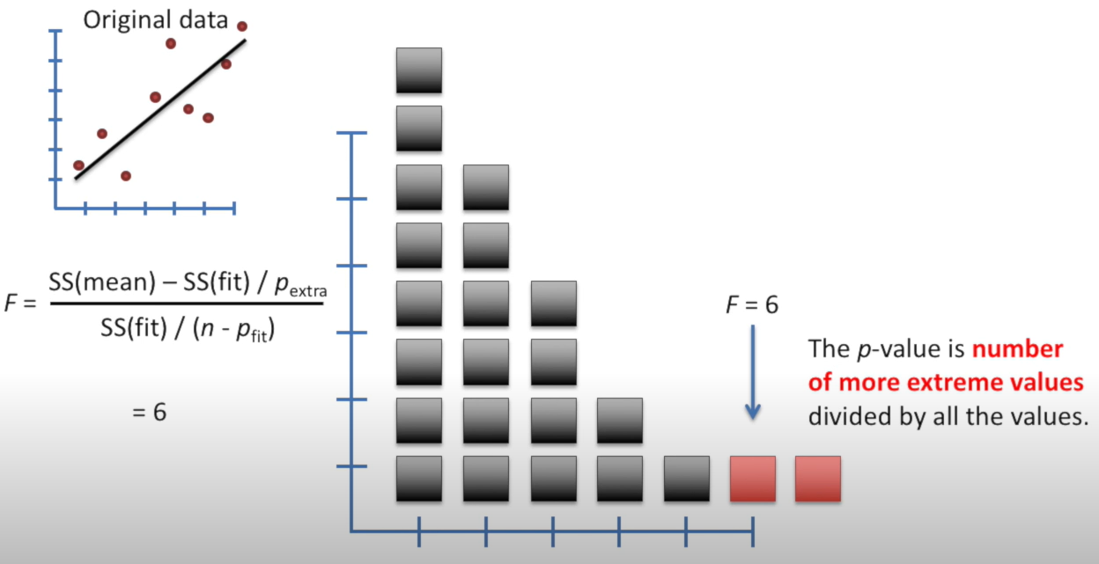
Calculating p-value

Slide 30
Overview
Significance of the Model:
The significance of a regression model tells us whether the relationship between the independent variables and the dependent variable is statistically valid. It is often tested using a hypothesis test (like the F-test) to determine whether the model is statistically significant. The null hypothesis typically states that the model with no independent variables explains the variability in the dependent variable just as well as your model does.
Goodness of Fit:
Goodness of fit refers to how well the model's predicted values match the observed data. In linear regression, this is often quantified by the R-squared (R²) statistic, which measures the proportion of the variance in the dependent variable that is predictable from the independent variables.
How They Differ:
The significance of the model is a binary concept—it tells us whether or not there is evidence to suggest that the model is useful for predicting the dependent variable. It's focused on the statistical validity of the model as a whole.
Goodness of fit, on the other hand, is a gradation—it gives us an idea of how much of the variance in the data our model can explain. It's focused on the explanatory power of the model.

Slide 31

Questions???

Slide 32

Thank you!!!

